Slide 1
Heart Disease Detection Using Machine Learning
Presented by:
Shreya Singhal-19btrcs075
Shreyas Nikhil-19btrcs076
shylaja.d.s-19btrcs077
Radhika sanghai-19btrcs117

Slide 2
Introduction
Heart disease is a term that covers all the possible disorders of the heart.
They have become a major concern to deal with as a studies show that the number of deaths due to heart diseases have increased significantly over the past few decades.
Thus preventing Heart diseases has become more than necessary.
A good data driven system can predict the possible risks of heart disease and thus helps to prevent it.
Machine learning helps in predicting the possible risks of heart disease.

Slide 3
Problem Definition
A dataset is formed by taking into consideration the information collected from around 900 individuals.
We have to predict based on the given information whether the individual will suffer from heart disease or not.

Slide 4
Dataset Information
Attributes:-
1. Age
2. Sex
3. cp: Chest pain type (4 values; 0: typical angina 1: atypical angina 2: non-anginal pain 3: asymptomatic)
4. trestbps: Resting blood pressure (in mm Hg on admission to the hospital)
5. chol: Serum cholesterol in mg/dl
6. fbs: Fasting blood sugar > 120 mg/dl(1 = true; 0 = false)
7. restecg: Resting electrocardiographic results(0: normal,1: having ST-T wave abnormality ,2: showing probable or definite left ventricular hypertrophy by Estes’ criteria)

Slide 5
Dataset Information(cont…)
8. thalach: Maximum heart rate achieved
9. exang: Exercise induced angina
10. Oldpeak= ST depression induced by exercise relative to rest
11. slope: The slope of the peak exercise ST segment(0: up-sloping 1: flat 2: down- sloping)
12. ca: Number of major vessels(0-3) colored by flourosopy
13. thal: thalium stress results. 0=normal; 1=fixed defect; 2=reversable defect
14. target: 0=not diagnosed 1=diagnosed

Slide 6
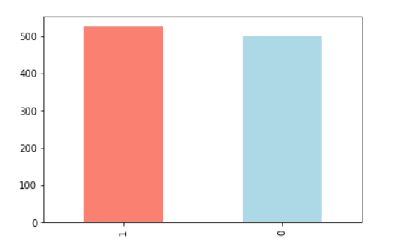
Analysis of data
1: Diagnosed with heart disease 0: Not diagnosed with heart disease

Slide 7
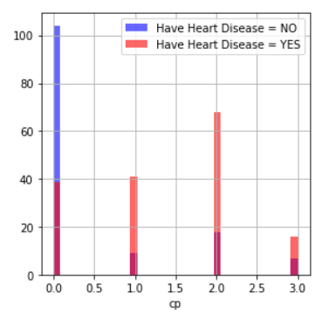
Analysis of data(cont…)
People with cp 1, 2, 3 are more likely to have heart disease than people with cp 0

Slide 8
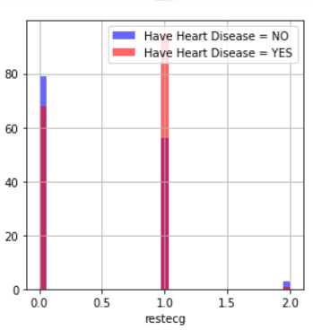
Analysis of data(cont…)
(resting ECG results): People with a value of 1 (reporting an abnormal heart rhythm, which can range from mild symptoms to severe problems) are more likely to have heart disease

Slide 9
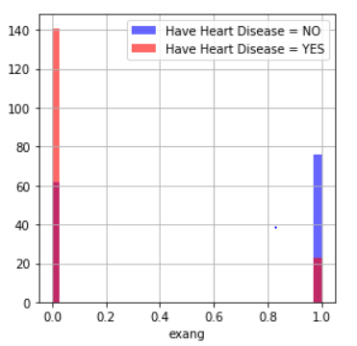
Analysis of data(cont…)
exang (exercise-induced angina): people with a value of 0 (No: angina induced by exercise) have more heart disease than people with a value of 1 (Yes: angina induced by exercise)

Slide 10
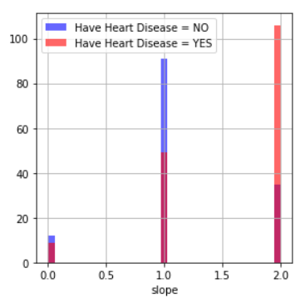
Analysis of data(cont…)
slope (the slope of the ST segment of peak exercise): People with a slope value of 2 (Down sloping: signs of an unhealthy heart) are more likely to have heart disease than people with slope 0 (Upsloping: best heart rate with exercise) or 1 (Flat sloping: minimal change (typical healthy heart)).

Slide 11
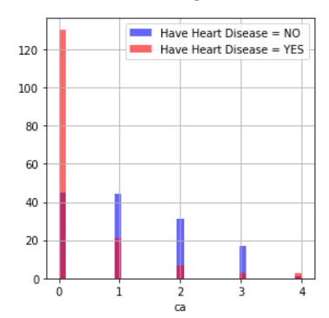
Analysis of data(cont…)
ca (number of major vessels (0-3) stained by fluoroscopy): the more blood movement the better, so people with ca equal to 0 are more likely to have heart disease.

Slide 12
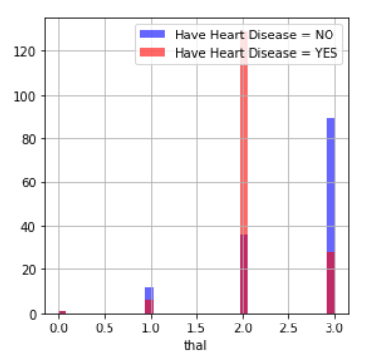
Analysis of data(cont…)
thal (thalium stress result): People with a thal value of 2 are more likely to have heart disease.

Slide 13
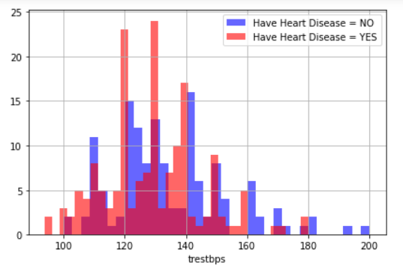
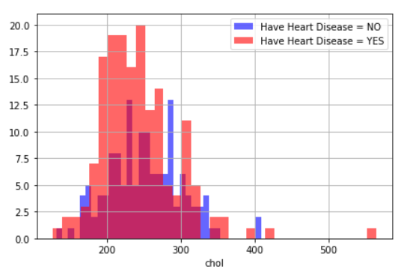
Analysis of data(cont…)
trestbps: resting blood pressure anything above 130-140 is generally of concern
chol: greater than 200 is of concern

Slide 14
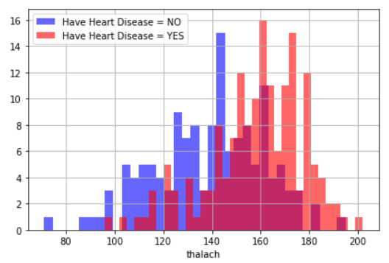
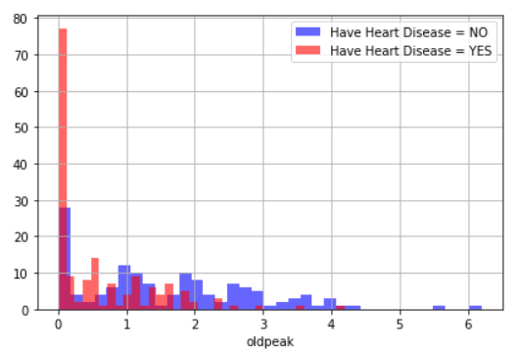
Analysis of data(cont…)
Thalach(maximum heart rate achieved): People with a maximum of over 140 are more likely to have heart disease.
the old peak of exercise-induced ST depression vs. rest looks at heart stress during exercise. An unhealthy heart will stress more.

Slide 15
Decision Tree Classifier
Decision Tree is a Supervised learning technique that can be used for both classification and Regression problems, but mostly it is preferred for solving Classification problems. It is a tree-structured classifier, where internal nodes represent the features of a dataset, branches represent the decision rules and each leaf node represents the outcome.
In a Decision tree, there are two nodes, which are the Decision Node and Leaf Node. Decision nodes are used to make any decision and have multiple branches, whereas Leaf nodes are the output of those decisions and do not contain any further branches.

Slide 16
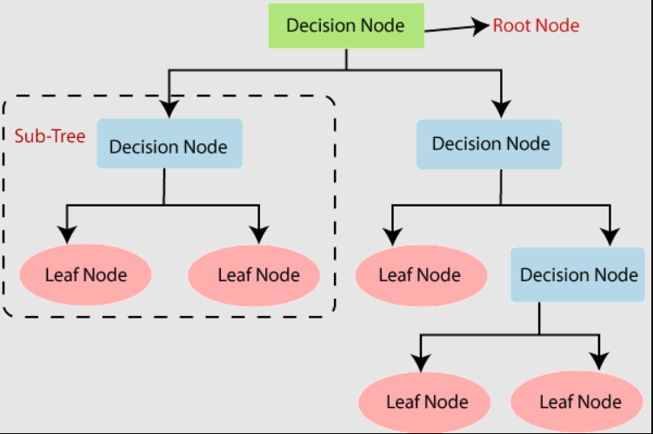
Decision Tree Classifier(cont…)

Slide 17
Decision Tree Classifier(cont…)
Advantages of Decision Trees:-
It is simple to understand as it follows the same process which a human follow while making any decision in real-life.
It can be very useful for solving decision-related problems.
It helps to think about all the possible outcomes for a problem.
Disadvantages of Decision Trees:-
The decision tree contains lots of layers, which makes it complex.
It may have an overfitting issue, which can be resolved using the Random Forest algorithm.
For more class labels, the computational complexity of the decision tree may increase.

Slide 18
Support Vector Classifier
Support Vector Machine or SVM is one of the most popular Supervised Learning algorithms, which is used for Classification as well as Regression problems. However, primarily, it is used for Classification problems in Machine Learning.
The goal of the SVM algorithm is to create the best line or decision boundary that can segregate n-dimensional space into classes so that we can easily put the new data point in the correct category in the future. This best decision boundary is called a hyperplane.
SVM chooses the extreme points/vectors that help in creating the hyperplane. These extreme cases are called as support vectors, and hence algorithm is termed as Support Vector Machine.

Slide 19
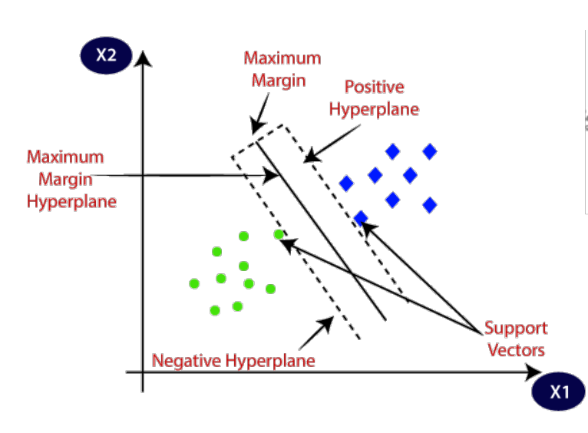
Support Vector Classifier(cont…)

Slide 20
Naïve Bayes Classification
Naïve Bayes algorithm is a supervised learning algorithm, which is based on Bayes theorem and used for solving classification problems.
It is mainly used in text classification that includes a high-dimensional training dataset.
Naïve Bayes Classifier is one of the simple and most effective Classification algorithms which helps in building the fast machine learning models that can make quick predictions.
It is a probabilistic classifier, which means it predicts on the basis of the probability of an object.

Slide 21

Naïve Bayes Classification(cont…)
It depends on the principle of Bayes' Theorem
Bayes' theorem is also known as Bayes' Rule or Bayes' law, which is used to determine the probability of a hypothesis with prior knowledge. It depends on the conditional probability.
The formula for Bayes' theorem is given as:
P(A|B) is Posterior probability: Probability of hypothesis A on the observed event B.
P(B|A) is Likelihood probability: Probability of the evidence given that the probability of a hypothesis is true.

Slide 22
Random Forest Classifier
Random Forest is based on the concept of ensemble learning, which is a process of combining multiple classifiers to solve a complex problem and to improve the performance of the model.
Random Forest is a classifier that contains a number of decision trees on various subsets of the given dataset and takes the average to improve the predictive accuracy of that dataset.
Instead of relying on one decision tree, the random forest takes the prediction from each tree and based on the majority votes of predictions, and it predicts the final output.
The greater number of trees in the forest leads to higher accuracy and prevents the problem of overfitting.

Slide 23
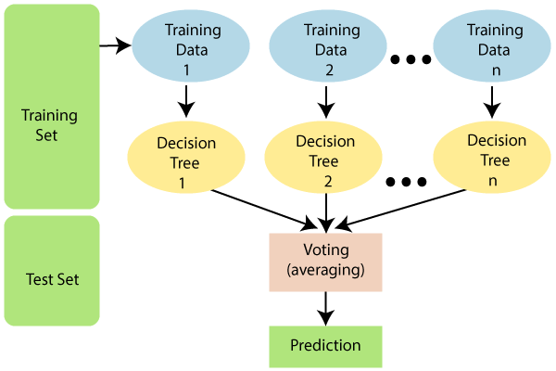
Random Forest Classifier

Slide 24
Logistic Regression
Logistic regression is used for predicting the categorical dependent variable using a given set of independent variables.
Logistic regression predicts the output of a categorical dependent variable. Therefore the outcome must be a categorical or discrete value. It can be either Yes or No, 0 or 1, true or False, etc. but instead of giving the exact value as 0 and 1, it gives the probabilistic values which lie between 0 and 1.
In Logistic regression, instead of fitting a regression line, we fit an "S" shaped logistic function, which predicts two maximum values (0 or 1).
The curve from the logistic function indicates the likelihood of something such as whether the cells are cancerous or not, a mouse is obese or not based on its weight, etc.

Slide 25
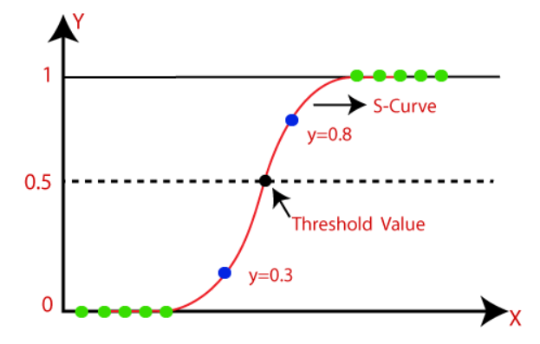
Logistic Regression(cont…)

Slide 26
Implementation Results
We achieved a 84% accuracy by using decision tree classifier to train the dataset
We achieved a 86% accuracy by using support vector classifier
We achieved a 80% accuracy by using naïve bayes classifier
We achieved a 86% accuracy by using random forest classifier
We achieved a 88% accuracy by using logistic regression

Slide 27
THANK YOU

